Slide 1
The UK Cross-Media Measurement Platform
Title: Template
Date

Slide 2
Welcome to Origin
We have provided a selection of basic PowerPoint slides for you to use to help better visualise your data from the excel reports. This template includes a glossary of terms and some prompts throughout, feel free to add or delete as you see fit to serve you own purposes. As always if you need any help at all please do reach out to us at the Customer Success team.
Keep an eye out for yellow boxes down the side of the slides to the right or left or yellow highlights on the page as they will provide some help with the templates and indicate the data that needs to change to be your own data.
Remember to write your own slide headers that better explain what your specific data is telling you, specifically with your campaign objectives in mind.
The data that is currently populating these charts is all synthetic data and in no way represents any real advertiser or media channel data.

Slide 3
Origin can answer many questions
There isn’t one fixed answer out of Origin. As planners you are constantly asking questions – establishing the best way to construct your campaigns together. Origin serves you data you couldn’t previously get before – single source, second by second, but it’s up to you how you use it.
At a basic level, Origin gives you your true, net campaign reach and frequency
In Flight Optimisation
Post Campaign Analysis
Strategic Planning
A core contributor to weekly reporting
Which media channels are delivering most effectively against our core KPI?
Frequency
Unique reach/ incremental reach
Quality reach - Viewability and view through rates
Cost per reach/ frequency
Flighting/ ad stock
This would enable you to move budget for short term course correction mid campaign
A core component of a PCA or a QBR. What did we learn last time and what could we do differently next time?
Which partners deliver most reach?
Which partners deliver most unique reach?
Which partners deliver most cost effective reach?
Who is driving frequency of message?
Who is driving view through rates – apples and apples comparisons on view through rates
How does our campaign cover and frequency build?
How can Origin contribute to bigger decisions for planning forward.
Investment behind my media partners (annual rate negotiations - trading)
Strategic role of the partners
Brand visibility in a time period – looking at my performance across multiple campaigns rather than just one campaign:
Total number of campaigns to run at any time
Creative placements / formats
View through rates
Frequency of message
Channel hierarchy in strategic planning
Most relevant target audience

Slide 4
3 use cases from the Origin Data
Unique Audience Reach and Duplication across platforms
Campaign Cover
Build & Frequency
Completed
Views
1
2
3

Slide 5
Glossary of key Terms to help you with your reports and analysis
(Siloed) Gross Reach
This is the campaign delivery that you currently measure in each of the individual platforms, all totalled up together. These platforms operate in isolation; advertisers will reach some of the same people in those channels on multiple occasions, but we don’t know where or how much. As advertisers, we want to know how many people our campaign reached in total, and what the average frequency of that message was, this is something that has never existed before Origin. Historically, we could only look at these 3 separate totals – if we add them all together we get a (siloed) Gross Reach number - we know this is incorrect as a Total Campaign Reach number but it is all we have had to work with until today.
Total Net Campaign Delivery - Reach & Frequency
The Origin platform and model was specifically created to get rid of that duplication and Gross Reach view. Origin, using its single source input allows us to measure the Total Net Campaign Delivery Reach and Frequency. This is the total number of your universe that saw your ad at least once (sometimes written as 1+) and the average frequency that the campaign message delivered against. You may see this written as something like 20m (29%) reach @ 4.4 OTS (opportunities to see) vs. All Adults.
Total Net Campaign Reach
This is the same as point 2 above, but is just the reach figure of all the people who saw your campaign. In the example above this is the 20m figure (29%).

Slide 6
Glossary of key Terms to help you with your reports and analysis
Duplication
Within the Origin platform and our analysis, we refer to Duplication as the excess or duplicated counting of people multiple times, due to the 3 siloed platforms we historically have had – artificial duplication really. Origin is getting rid of this artificial duplication level to give you your actual Total Net Campaign Delivery. Please note that we use this to make the transition from Gross reach to Net reach and campaign delivery. This shouldn’t be confused with the overlap of platforms where an individual has seen the campaign, but may have seen it on more than one platform. Think of Origin as having two layers, the first layer is de-duplicating the total audience (i.e. the double counting of individuals due to the siloed approach previously used), the second layer is then about looking at where the overlaps exist within your Total Net Campaign Reach.
Unique Reach
We use the phrase Unique Reach to refer to the reach of a vendor that is totally unique to them. i.e. this is the number of people that only ever saw your campaign with that particular vendor. Take an example, if we state that Vendor 1 delivered 5m Unique Reach, that would mean that if you hadn’t put Vendor 1 on your plan, then those 5m individuals would never have seen your campaign at all, as there was no other overlap with any other vendors.
Overlap
This is where we are seeing individuals being reached with the campaign across multiple vendors, i.e. 2 or more. We are measuring this overlap within our universe size of the Total Net Campaign Reach – so we are not double or triple counting them (duplicating them), we are only counting them in the actual places they showed up and not counting their 1+ reach multiple times.

Slide 7
3 use cases from the Origin Data
Unique Audience Reach and Duplication across platforms
Campaign Cover
Build & Frequency
Completed
Views
1
2
3

Slide 8
Planning in isolation – we know in this campaign example, a minimum of 31m adults were reached (Vendor 1 delivery in isolation)
These are text boxes add in your campaign information, the Vendor 1, 2, 3 should be replaced with the Media Channel’s in your report e.g. Meta, YouTube or Linear TV
Vendor 1
Vendor 2
Vendor 3
Reach (inc. Duplicated Counts)
31m
5.2m
13.5m
Impressions
3m
5.2m
25.0m
Average
Frequency
4.99
1.07
1.94
Duration
11 Weeks [Data from date to date]

Slide 9
But we don‘t know how many in total - we know this figure of 49.7m includes duplication across the platforms, so how many adults did we reach with the campaign in total?
These are text boxes add in your campaign information, the Vendor 1, 2, 3 should be replaced with the Media Channel’s in your report e.g. Meta, YouTube or Linear TV
These are text boxes add in your campaign information, the Vendor 1, 2, 3 should be replaced with the Media Channel’s in your report e.g. Meta, YouTube or Linear TV
TOTAL
Vendor 1
Vendor 2
Vendor 3
+
+
=
Reach (inc. Duplicated Counts)
31.0m
5.2m
13.5m
49.7m
Impressions
147.3m
5.2m
25.0m
177.5m
Average
Frequency
4.99
1.07
1.94
4.64
Duration
11 Weeks [Data from date to date]

Slide 10
Origin enables you to see your Total Campaign Delivery - Reach and Frequency for the first time. Your campaign reached 40.1m (69%) individuals @ 4.64 OTS vs. All Adults
These Venn’s are simple representations, they are free drawn using shapes, not to scale, but it’s a good idea to make them relative to one another
Siloed Gross Audience Reach (31 + 13.5 + 5.3 ≠49.7m)
Total Net Campaign Reach (40.1m)
31.0m
5.2m
Vendor 2
Vendor 1
Vendor 1
13.5m
Vendor 2
Vendor 3
Vendor 3
*not to scale
*not to scale
Therefore 9.5M (19.2%) of the Gross Reach count were due to duplication – where an advert reaches an individual multiple times across multiple platforms and we are potentially double or triple counting them in assuming total campaign reach
Notes:
2.47, 0.95, 5.68

Slide 11
Origin can tell us which channel delivered the greatest unique reach (i.e. Individuals that were not reached via any other platform) If you overlay cost you can see which channels are delivering most cost efficient unique reach
Copy your data over into the data sheet behind this chart. The numbers in the bar chart should update.
The key is a manual text box update, and the total numbers at the top of the bars are also text boxes. If you wanted to add % text boxes manually, you could, for example Vendor 1, delivers 71% unique reach (22.1m is 71% of 31m)
31.0m
Vendor Channel Reach
Adults Millions, Total Reach (+1)
Vendor 1 Unique Audience
Vendor 2 Unique Audience
13.5m
Vendor 3 Unique Audience
Duplicated Audience & Cross Platform
71%
5.2m
___
___
___
CAN BE FILLED
WITH YOUR DATA
Total spend (£)
___
___
___
Cost per 1,000 (£CPM)
CPM = Cost/ Impressions x 1000

Slide 12
Of all those individuals that saw your campaign at least once (the Total Net Campaign Reach) Origin then measures the cross-over of vendors on your plan​
Copy your data over into the data sheet behind these two charts. The numbers inside the bar chart should update automatically. Remember with the waterfall chart you will need to manually calculate the values for the white bars that allow for the waterfall effect (these are highlighted yellow in the datasheet).
Gross Audience Deduplication
Adults Millions
Breakdown of Total Net Campaign Reach
Adults Millions
Adults reached uniquely via a single vendor platform accounted for 31.1m Adults or 78% of the Total Net Campaign Reach
9m Adults or 22% of the Total Net Campaign Reach saw your campaign with 2 or more vendors

Slide 13
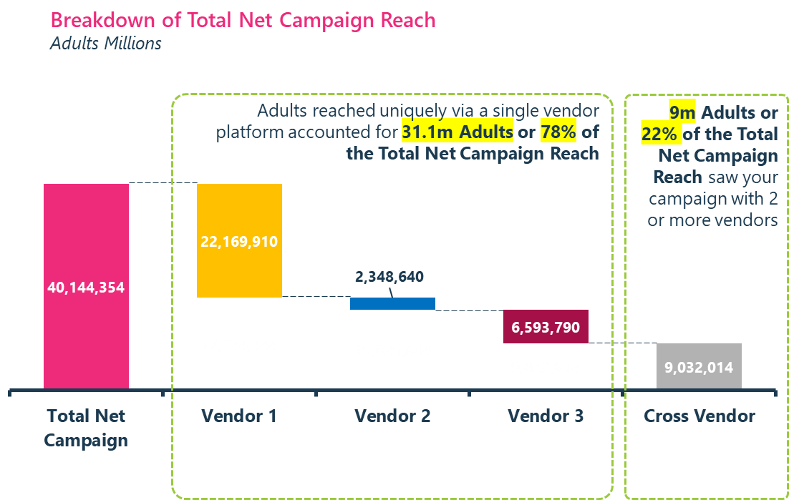
And therefore, we know that 9.0m saw your ad on two or more of the vendors – the cross-over (22% of the Total Net Campaign Delivery)
These slides are all manual text boxes and shapes. The image on the right hand side is an image of the chart on the previous slide.
In order to highlight the middle of your Venn use the ‘Shape Format’ tab and the ‘Merge Shapes’ option
Total Net Campaign Delivery (40.1m)
Total Unique Audience (1+) Reach (40.1m Adults)
22.2m
Vendor 1
2.3m
6.6m
9.0m
Vendor 2
Vendor 3
*not to scale

Slide 14
Having all of this knowledge can start to help you reconstruct the campaign based on the most important parameters (e.g. just unique reach, or cost per unique reach)
Copy your data over into the data sheet. These numbers come from the Incremental Reach tab.
Remember with the waterfall chart you will need to manually calculate the values for the white bars that allow for the waterfall effect (these are highlighted yellow in the datasheet).
Incremental Unique Reach
Adults Millions, Total Reach (+1)
This document has been created with synthetic data for illustrative purposes only

Slide 15
Origin helps users frame the questions around campaign performance
Questions to consider
Was duplication of audiences in line with expectations?
Could you improve suppression tactics to minimise unnecessary duplication?
How did each vendor perform vs. what you expected from a planning stage?
How did you target each channel, could this have contributed or taken away from the duplication?
Could channel-specific targeting have increased or reduced overlap?
Should you upweight or down-weight specific vendors based on performance?
How could I shift budgets to optimise the balance between total reach, unique reach, and cost efficiency?
Are certain channels driving excessive duplication, and should budgets be reallocated to maximise unique reach?
If this were a post-campaign analysis (PCA), would I adjust budget splits next time to improve efficiency?
How do the CPM and CPH compare across channels, and where can cost savings be achieved without sacrificing reach?
How can I build most incremental reach – who do I anchor first?

Slide 16
3 use cases from the Origin Data
Unique Audience Reach and Duplication across platforms
Campaign Cover
Build & Frequency
Completed
Views
1
2
3

Slide 17
We can chart the total net campaign 1+ cover build over the campaign period
Note:
Vendor values include duplicates (Gross)
Copy your data over into the data sheet. The numbers should update automatically.
Cumulative Audience Reached
Adults Millions, Cumulative Reach (+1)

Slide 18
As well as the reach across the different frequency levels
Copy your data over into the data sheet. The numbers should update automatically.
Audience Reached by Frequency
Adults Millions

Slide 19
Origin helps users frame the questions around campaign frequency and cover build
Questions to consider
Was frequency too high on certain channels and should you redistribute budget from Vendor 1 to digital platforms to balance exposure and reduce ad fatigue?
Have you combined reach, engagement, and conversion data to define the optimal exposure threshold per platform?
Are you optimising for efficiency by moving beyond raw impressions to optimised frequency modelling?
Are you optimising frequency cross-platform?
Have you tested different frequency caps to determine the ideal exposure per user before reaching diminishing returns?
Was the pacing strategy optimal? Should more budget have been front-loaded to maximise reach earlier in the campaign?
Should future campaigns test alternative pacing?
Could Vendor 3 or Vendor 2 have been upweighted earlier in the campaign to drive stronger reach in the first two weeks?
Did Vendor 1 sustain engagement throughout, or did reach plateau too early? Was the campaign length aligned with media delivery?

Slide 20
3 use cases from the Origin Data
Unique Audience Reach and Duplication across platforms
Campaign cover
Build & Frequency
Completed
Views
1
2
3

Slide 21
Origin allows you to filter your data in 3 ways
AMI (All Measurable Impressions) – this is all impressions that were served on the platform
MRC Standard – this is a minimum of 2 seconds of viewability based on a set of guidelines and criteria established by the Media Rating Council (MRC)
Custom – here you can define your own % completion metric (e.g. 50% or 100%)
Please note Meta data is only available as AMI

Slide 22
Gap analysis: 81.2% of the total audience viewed the campaign to the end across Vendor 3 and Vendor 1 by Week 11
Copy your data over into the data sheet. The numbers should update automatically.
Please note text boxes for manual calculations.
Total Reach 1+ (AMI) | 40,467,840
100% VTR | 32,868,360
Cumulative Audience Reached with 100% Video Exposure – Total Campaign
Adults Millions, Cumulative Reach (+1)
81%
All Measurable Impressions
Custom (100% VTR)

Slide 23
90% of the Vendor 1 audience viewed the advert to the end by Week 11, compared to 70% for Vendor 3
Cumulative with 100% VTR – Vendor 3
Adults Millions, Cumulative Reach (+1)
Cumulative with 100% VTR – Vendor 1
Adults Millions, Cumulative Reach (+1)
70.0% of the audience viewed the ad to the end by Week 11
90.0% of the audience viewed the ad to the end by Week 11
All Measurable Impressions
Custom (100% VTR)
All Measurable Impressions
Custom (100% VTR)
Total Reach 1+ (AMI) | 13,652,310
100% VTR | 9,553,425
Total Reach 1+ (AMI) | 30,996,000
100% VTR | 27,909,000

Slide 24
Origin helps users frame the questions around the completion rates of your campaign
Questions to consider
Was the same creative used across Vendor 1 and Vendor 3, or was it tailored to match how audiences engage with each channel?
What types of formats and specific placements were used to account for the difference
Did we use different targeting tactics within the digital space?
How does engagement correlate with conversion? Did the high completion rates translate into meaningful business outcomes (e.g., sales, brand lift)?

Slide 25
Thank you
Hopefully this has demonstrated some of the value that Origin provides. We’d love to answer any further questions and work closely with you to help optimise your reports.
© Origin 2025

